Slide 1
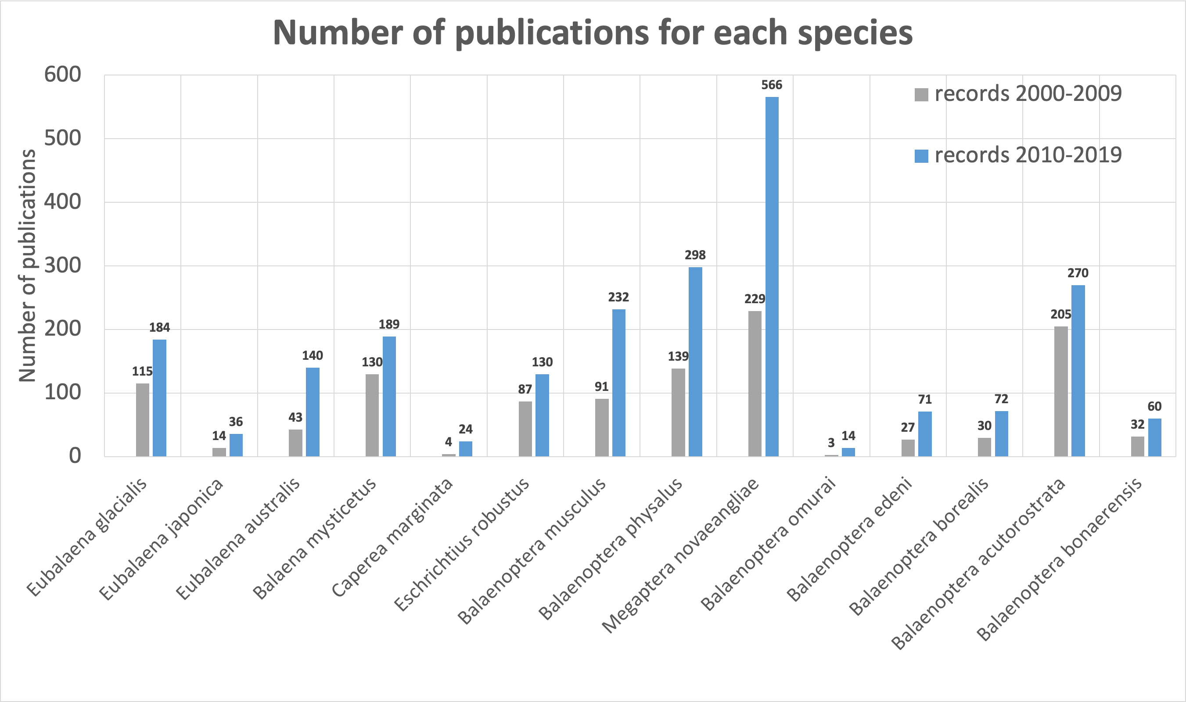

Slide 3
Family
1 Balaenidae
2 Neobalaenidae
3 Eschrichtiidae
4 Balaenopteridae
2
3
4
NT
CR
EN
LC
LC
LC
LC
LC
VU
DD
Least Concerned | LC
Near Threatened | NT
Vulnerable | VU
Endangered | EN
Critically Endangered | CR
Data Deficient | DD

Slide 4
Family
1 Balaenidae
2 Neobalaenidae
3 Eschrichtiidae
4 Balaenopteridae
NT
CR
EN
LC
LC
LC
LC
LC
VU
DD
Least Concerned | LC
Near Threatened | NT
Vulnerable | VU
Endangered | EN
Critically Endangered | CR
Data Deficient | DD

Slide 5
Least Concerned | LC
Near Threatened | NT
Vulnerable | VU
Endangered | EN
Critically Endangered | CR
Data Deficient | DD
LC
NT
VU
EN
CR
DD
Family
1 Balaenidae
2 Neobalaenidae
3 Eschrichtiidae
4 Balaenopteridae

Slide 6
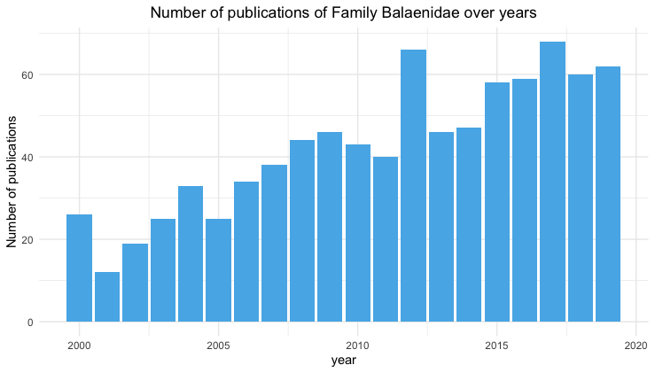
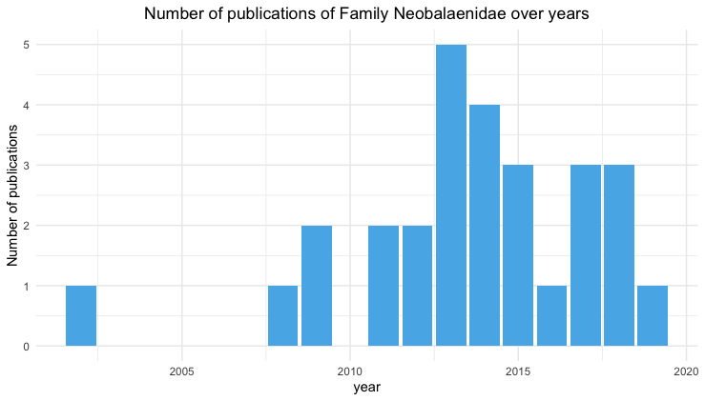
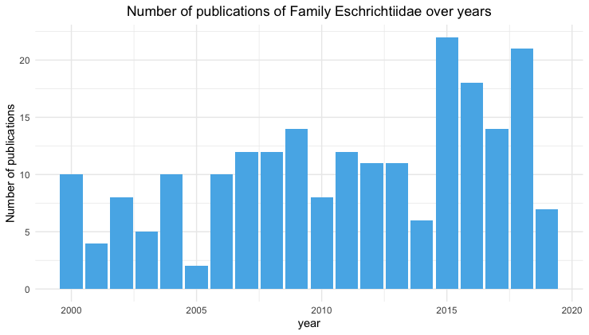
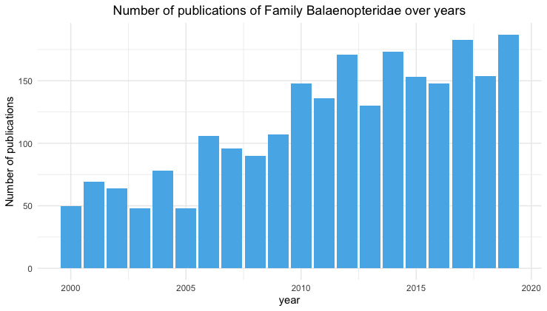
Trend of publications in 4 families

Slide 7
Proportion of families

Slide 8
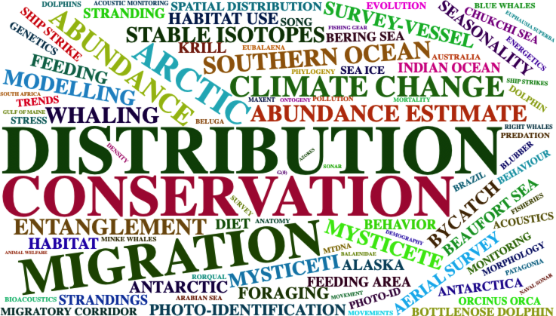
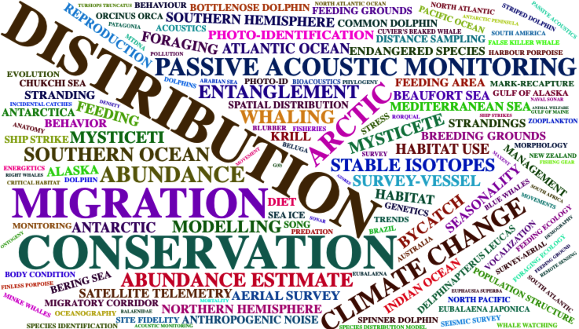
Word Clouds
2000-2009 Word Cloud
2010-2019

Slide 10
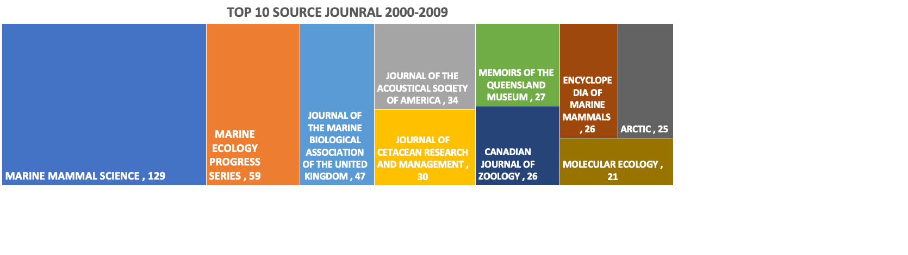
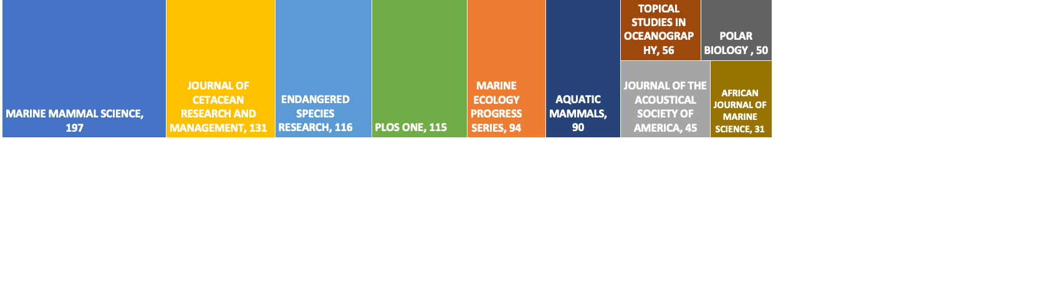

Slide 11
2000-2009

Slide 12
2010-2019

Slide 13
Photo by Paola Ocaranza on Unsplash

